Slide 1
Analysis of Schools in San Diego Neighborhoods

Slide 2
INTRODUCTION
I live in San Diego, CA. So, I have decided to explore and analyze neighborhoods in this wonderful city to understand, is it any correlation between median household income and amount of schools in this neighborhood.
The main question is:
Does it mean that in the richest neighborhoods more and better schools (Elementary, Middle, High) than in Poorest Neighborhoods?

Slide 3
Target Audience:
* Families with kids, who moving in in San Diego. They know their income, they want their kids to go to the right school, so this will help them to find right place.
* Budding Data Scientists, who wants to implement some of the most used Exploratory Data Analysis techniques to obtain necessary data, analyze it and, finally be able to tell a story out of it.

Slide 4
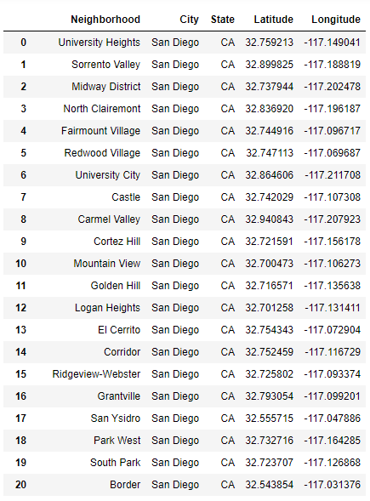
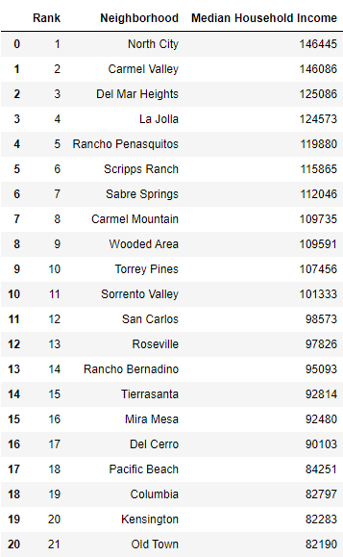
GeoJSON file
I found the great GeoJSON file Zillow Neighborhoods that consists of all USA Neighborhoods with latitude and longitude information. After filtering and cleaning data we get dataframe with all neighborhoods in San Diego City (NOT COUNTY!).
Web-Scrapping
Then we scraped Richest Neighborhoods In San Diego For 2020 using Beautiful Soup library. This web page represents "List Of The Richest Neighborhoods In San Diego For 2020".

Slide 5
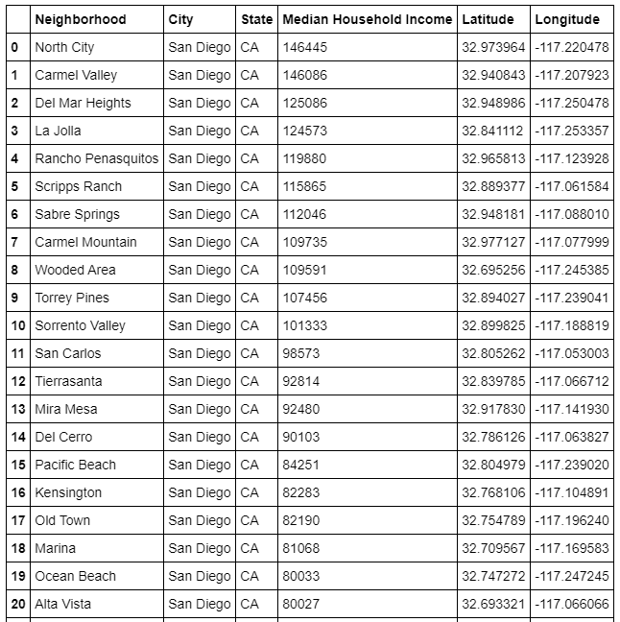
Completed San Diego Neighborhoods Data Frame
I had to merge 2 above dataframes to get final dataframe that we will work with.

Slide 6
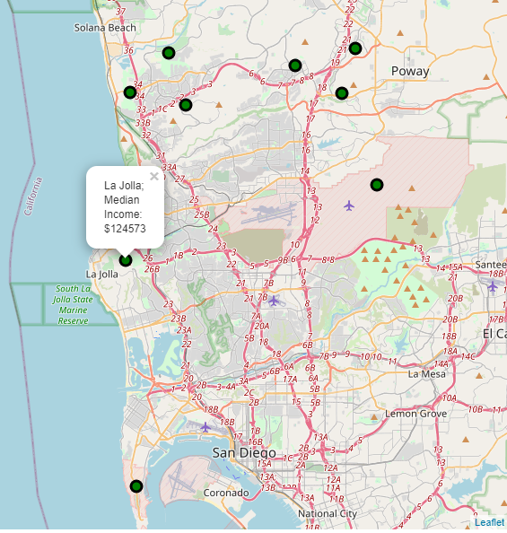
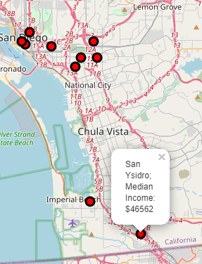
After manipulation with data we create 2 separate dataframes: 10 Richest Neighborhoods and 10 Poorest Neighborhoods and plot them on the map using FOLIUM library
We can see, the Poorest Neighborhoods located closer to Downtown and near Mexico border, the Richest are close to the ocean and north of all other neighborhoods.

Slide 7
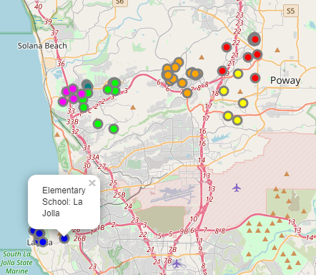
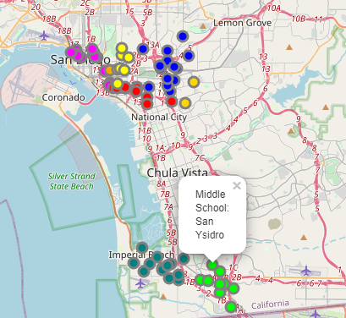
Exploring the School Data and Neighborhood of San Diego
From the Foursquare data, There are 95 schools in Richest Neighborhoods in radius of 2000 meters (1.25 miles) and 78 schools in Poorest Neighborhoods in radius of 2000 meters (1.25 miles).
I have used Folium library to plot a leaflet map of only these schools in Richest and Poorest Neighborhoods which are as shown below.
Richest Neighborhoods:
Poorest Neighborhoods:

Slide 8
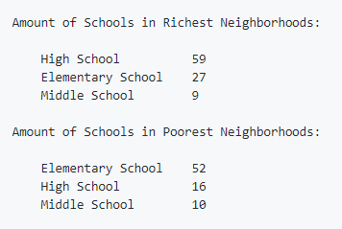
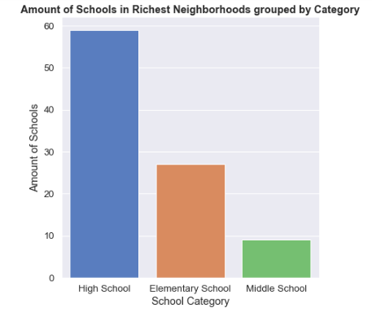
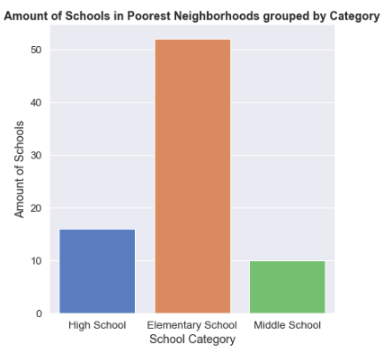
Using Seaborn and Matplotlib libraries let's visualize this information below:

Slide 9
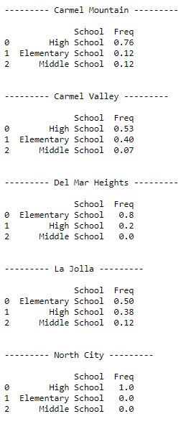
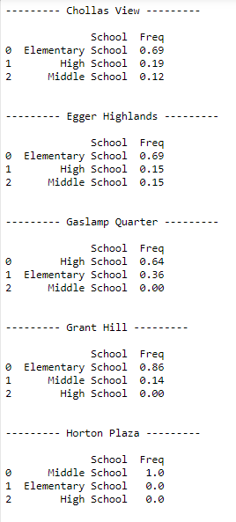
Next step was to obtain information about the school categories of each neighborhood. And to do that, I proceed as follows:
* Create a data-frame with pandas one hot encoding for the school categories.
* Use pandas groupby on Neighborhood column and obtain the mean.
* Transpose the data-frame at step 2 and arrange in descending order.
Richest Neighborhoods:
Poorest Neighborhoods:

Slide 10
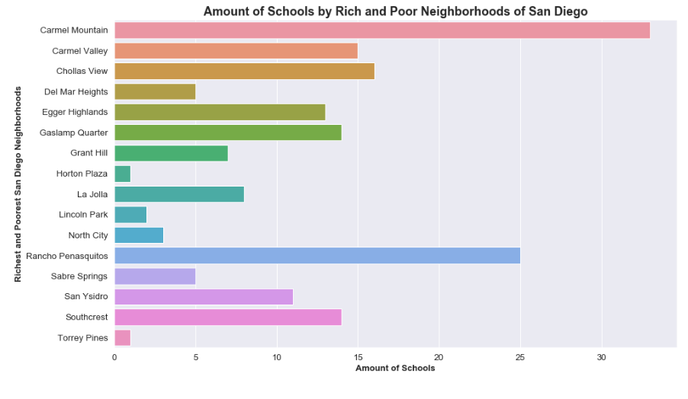
Also I wanted to explore which neighborhood has the highest amount of schools and the plot below is the answer:

Slide 11
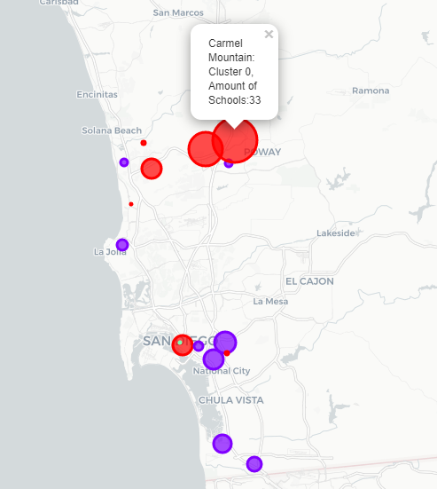
Clustering the Richest and Poorest San Diego Neighborhoods
Finally, we try to cluster Richest and poorest neighborhoods based on the frequency of school categories and, use K-Means clustering. So our expectation would be based on the similarities of school categories, these neighborhoods will be clustered.
Using K-Means Algorithm from Scikit-Learn Library we obtain 3 clusters as shown below.
Here the radius of the circles represent the amount of schools.
The color represents clusters:
Red - Cluster 0
Purple - Cluster 1 Green - Cluster 2

Slide 12
Results
Richest Neighborhoods has more schools then Poorest Neighborhoods.
Elementary Schools top the charts of most common schools in the Richest and Poorest Neighborhoods.
Carmel Mountain and Rancho Penasquitos has more schools then other neighborhoods.
Richest Neighborhoods has more High Schools.
Poorest Neighborhoods has more Elementary Schools.

Slide 13
Conclusion
We have got a small glimpse of how real life data-science projects look like. I have made use of some frequently used python libraries to scrap web-data, use Foursquare API to explore the San Diego Neighborhoods and saw the results of segmentation of Neighborhoods using Folium leaflet map.
Finally, If you have kids and you are planning to move in San Diego, you can find the best and right place for you, using this analysis.

